Slide 1
Infer Cause of Death for Population Health Using Convolutional Neural Network
Sourse : BCB 2017
Advisor : JIA-LING KOH
Speaker : YI-CHENG HUNG
Date:2018/02/06

Slide 2
Outline
Introduction
Method
Experiment
Conclusion

Slide 3
Outline
Introduction
Method
Experiment
Conclusion

Slide 4
Introduction
The cause of death is I25.
死亡證明
Notes:
環境:從死亡證明中的icd10sequenc中predict 最為可能性的icd10 code

Slide 5
Introduction-motivation
challenges | Traditional one hot vector
 | Large dimension of inputs
 | feature extraction will require large computation resources
 | 無法處理序列長度不同的inputs
Notes:
動機:傳統模式跟CNN方式的比較

Slide 6
Introduction-goal
Notes:
目的:以CNN 的方式,從死亡證明中的icd10sequenc中predict 最為可能性的icd10 code

Slide 7
Outline
Introduction
Method
Experiment
Conclusion

Slide 8
Method-CNN
Notes:
整體架構→各層設定及說明

Slide 9
Method-CNN
Vocabulary(詞彙表) of ICD-10 conditions
Notes:
整體架構→各層設定及說明

Slide 10
Method-CNN
D
Word embedding[28]
Notes:
整體架構→各層設定及說明

Slide 11
Method-CNN
D
H
k
卷積運算子
bias
The setting of kernel size for the convolution layers are 3,5,7
Activation Function:Tanh,ReLU
Notes:
整體架構→各層設定及說明

Slide 12
Method-CNN
Maximum
Pooling
Average
Notes:
整體架構→各層設定及說明
影像辨識中常用的是最大池化

Slide 13
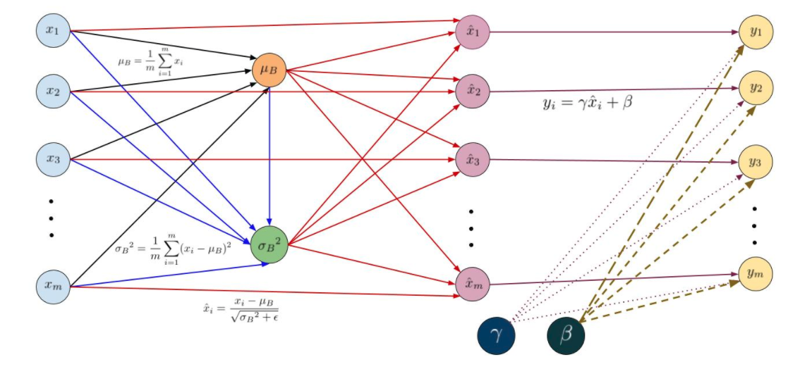
Method-CNN
優點:快速學習、不會過度依賴預設值、控制過度學習(減少Dropout的必要)
Γ,β為參數,初設為Γ =1, β =0，藉由學習調整為適當值。
Notes:
批次正規化

Slide 14
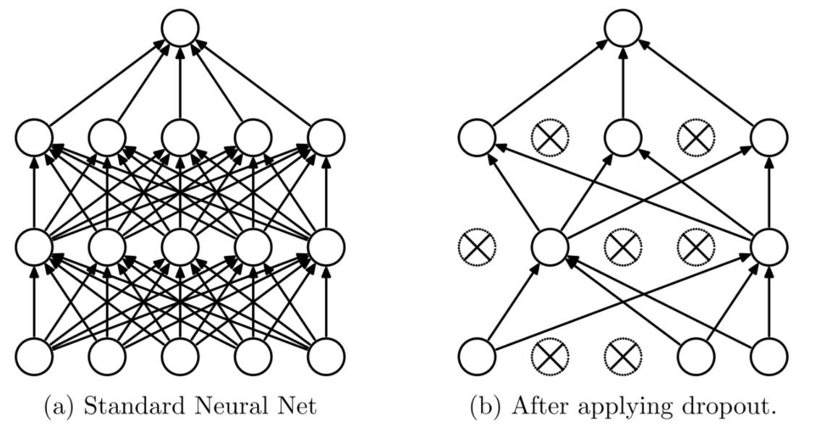
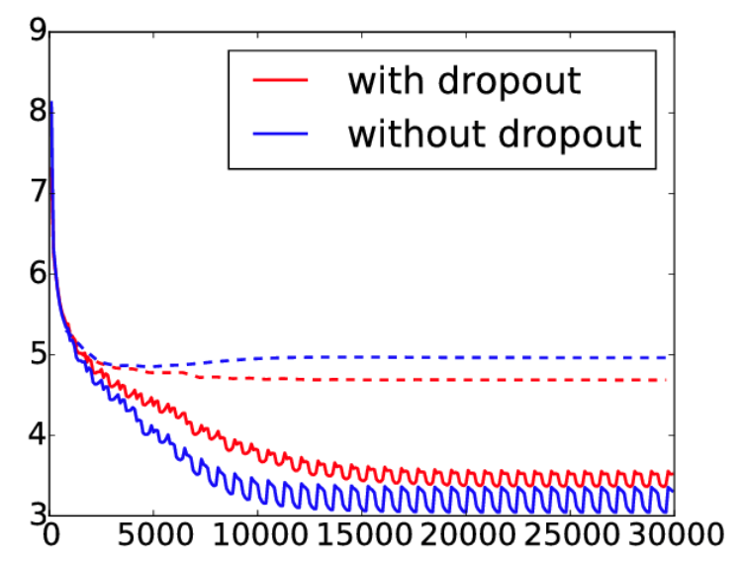
Method-CNN
Test error
Test
Train
目的:用以減少過度學習(overfitting)

Slide 15
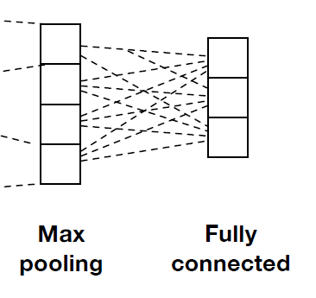
Method-CNN
Notes:
整體架構→各層設定及說明
影像辨識中常用的是最大池化

Slide 16
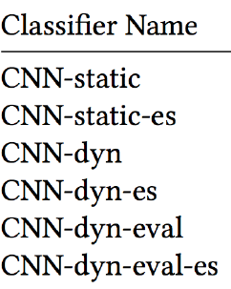
Configurations of CNN
Static
Dynamic
ES
eval
ES
ES
Model is built with PyTorch
parameter | setting
embedding dimension | 128
three kernel sizes for the convolution layers | 3,5,7
Dropout probability | 0.5
maximum norm(L2 norm) | 3.0

Slide 17
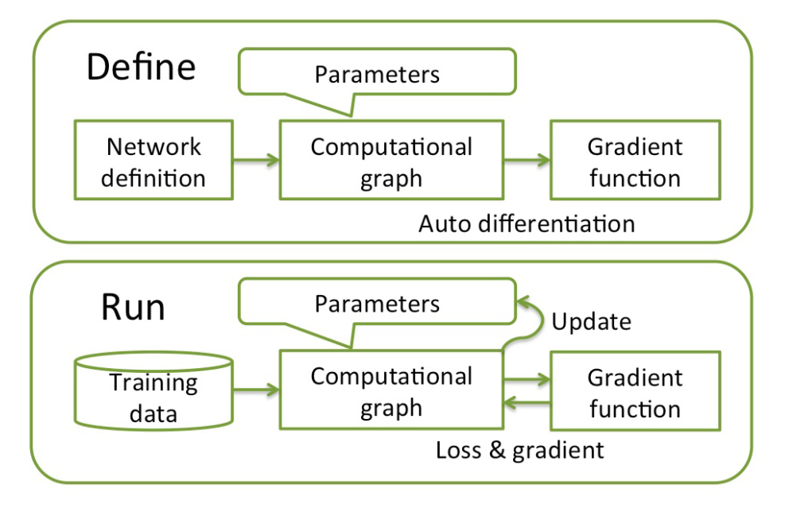
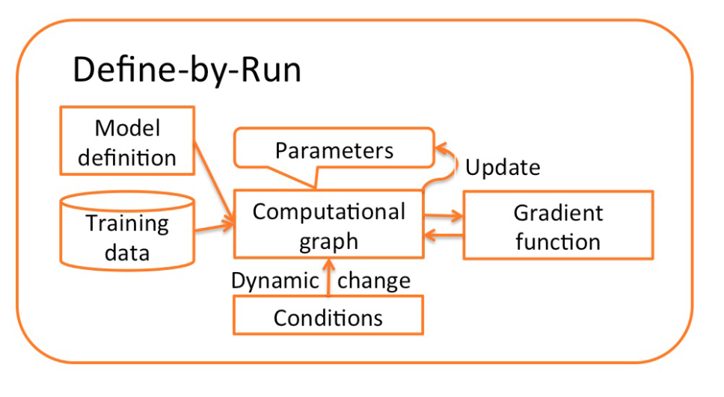
How to dynamically build neural network?
(TensorFlow)
(PyTorch,Chainer)

Slide 18
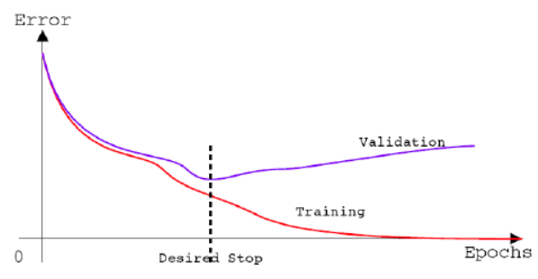
Early stopping
優點:節省可觀的時間，並保持效能
首先將一小部分訓練集作為我們的開發集
每一個epoch(週期) 結束時，計算開發集的accuracy
一旦我們觀察到開發集上性能越來越差
但測試性能超過了我們預先設定的值
可能 overfitting，終止訓練過程
Notes:
我們首先將一小部分訓練集作為我們的開發集，然後在其餘的訓練集上進行訓練。 一旦開發集上的測試性能比其餘的訓練性能差，並且測試性能超過了我們預先設定的閾值，則可以得出結論：訓練可能已經過度裝配數據，並終止訓練過程。

Slide 19
Outline
Introduction
Method
Experiment
Conclusion

Slide 20
Experiment
Dataset overview
Baseline method
Experiment Settings
Evaluation Metrics
Experiment Results
Parameter Analysis
Analyzing Embeddings of Medical Conditions

Slide 21
Experiment-Dataset overview
2 million death certificates in the U.S. from2014
Removing identical records and filter out records with length less than 3
Obtain 1,499,128 records.
1610 input conditions
1180 possible classes as cause of death

Slide 22
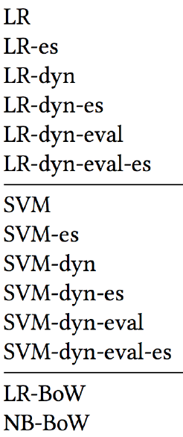
Experiment-Baseline method
Feature extraction | classifiers
BoW-bag of word | Naive Bayes、Logistic Regression
Word embedding | Shallow
Architectures of shallow classifiers:

Slide 23
Experiment-Settings
 | Training set | Development set | Test sets
資料集的切割 | 7.9 | 0.1 | 1
 | BoW | CNN 、Shallow
硬體 | CPU+60GB RAM | NVIDIA K80 GPU
Mini-batch |  | 64
epoch |  | 2

Slide 24
Experiment-Evaluation Metrics
Accuracy(ACC)
Cross Entropy Loss
F1 score
Cohen’s kappa
K=1,代表完全吻合

Slide 25
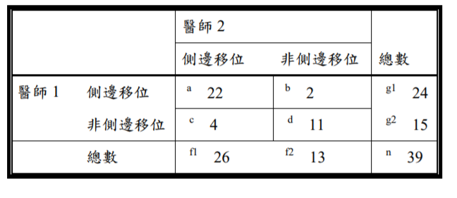
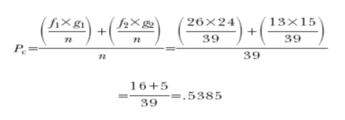
Experiment-Cohen’s kappa
K=1,代表完全吻合

Slide 26
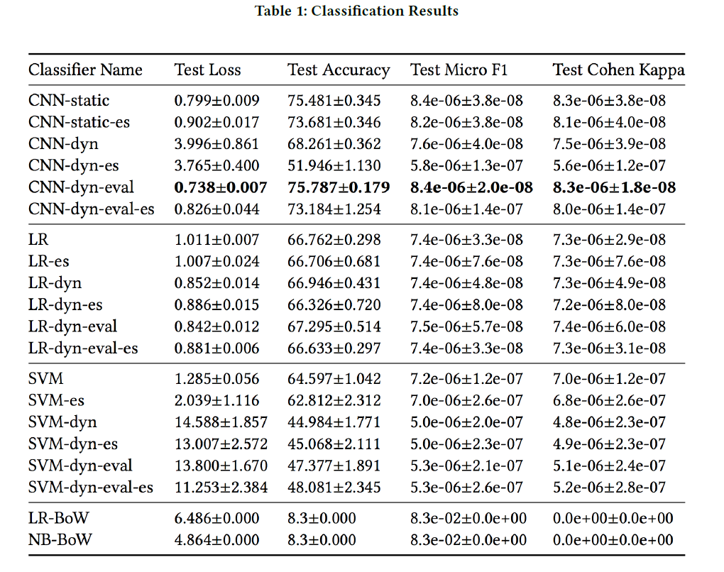
Classification Results

Slide 27
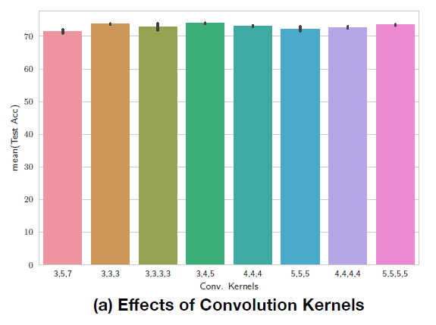
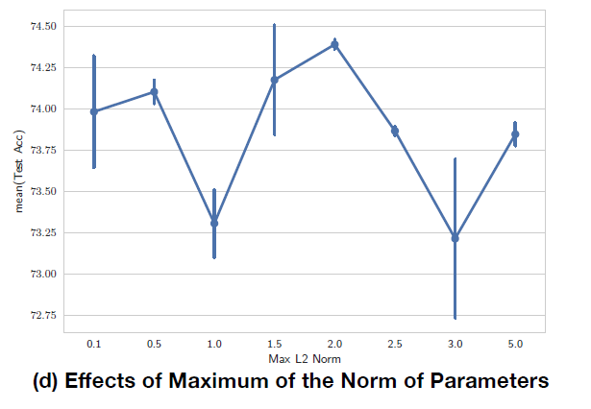
Experiment-Parameter Analysis
The base model is the standard static version of CNN

Slide 28
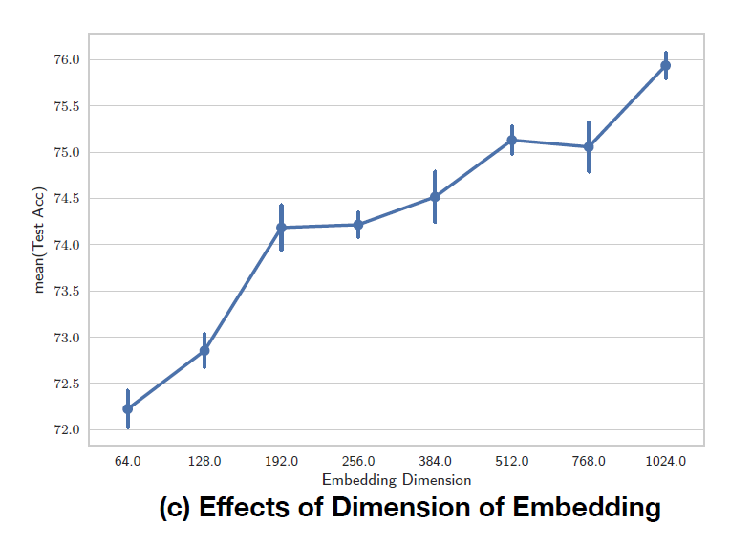
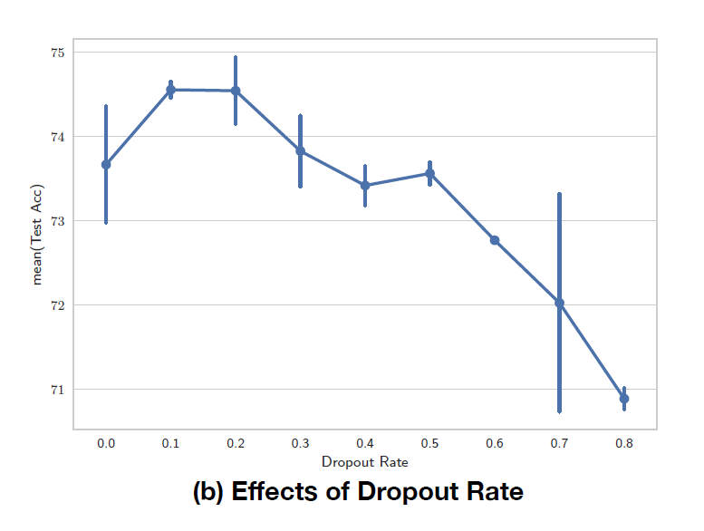
Experiment-Parameter Analysis
The base model is the standard static version of CNN

Slide 29
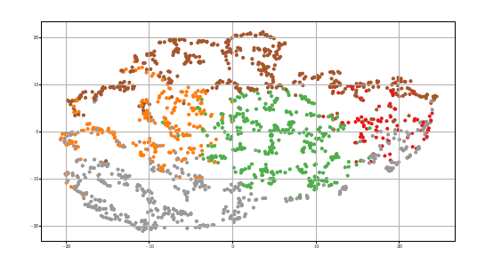
Experiment-Analyzing Embeddings of Medical Conditions
side-product

Slide 30
CONCLUSION
This paper showed how a modern deep learning architecture (CNN)can be adapted to identify the cause of death.
The model shows significant improvement over the traditional baselines
Handle even larger scale datasets than traditional methods
Provide human understandable interpretation for the model
Notes:
現在的深度學習架構CNN模型對資料集的高適應性

